Slide 1
CE Expert System
Release 39.0
---
Form Changes

Slide 2
Multiple BRPA Matrices in Single Packages (CQ #179)
The system now produces a BRPA matrix for every structure and roadway associated with every MPMS project on a given BRPA package.

Slide 3
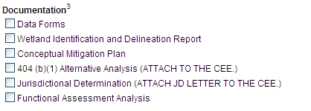
Changes to Required Attachments (CQ #148)
Throughout all forms, specific references to required attachments have been removed, such as “(ATTACH TO THE CEE.)”
A new FAQ has been associated with all forms that explains the new attachment requirements. There are fewer required attachments than before this release.
FAQ wording encourages users to not attach non-required documentation, but instead keep files with Technical Support Data.

Slide 4
Changes to Required Attachments (CQ #148)
Throughout all forms, attachment notes have been changed to reflect removal of “(ATTACH TO CEE)” from document lists.
For example, guidance starting with “Unless otherwise noted” has been changed to “Unless required”.

Slide 5

Changed References to DM-1B (CQ #191)
Throughout all forms, changed references from “CE Handbook” to “DM-1B (Pub #10B)”.

Slide 6
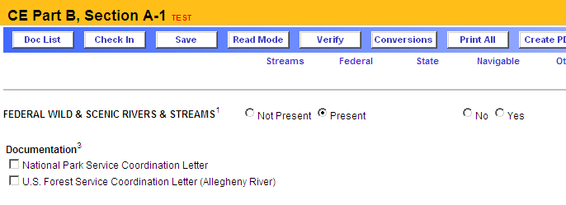
CE Part B, Section A-1 --- Federal Wild & Scenic (CQ #182)
Added “Clarion River”.

Slide 7
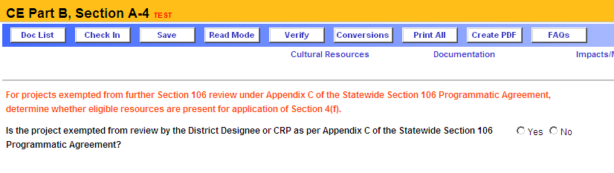
CE Part B, Section A-4 --- Cultural Resources (CQ #181)
Added “Is the project exempted … per Stipulation III of the Emergency Relief Projects Programmatic Agreement (2005)?” with fields for Activity Selection (see next page), Individual Making Exemption and Date of Exemption.

Slide 8
CE Part B, Section A-4 --- Cultural Resources (CQ #181)
Exempt Activity Selections for previous slide…
Immediate rescue and salvage operations conducted to preserve life and property
B.1 Repair of road
B.2 Repair or replacement of traffic control devices
B.3 Repair or replacement of road lighting
B.4 Repair or replacement of other road appurtenances
B.5 Repair or replacement of roadway safety elements
B.6 Repair or replacement of culvert systems
B.7 Placement of fill or repair of scour
B.8 Repair or replacement of retaining walls
B.9 Channel cleaning
B.10 Other activities necessary to restore and maintain essential traffic

Slide 9
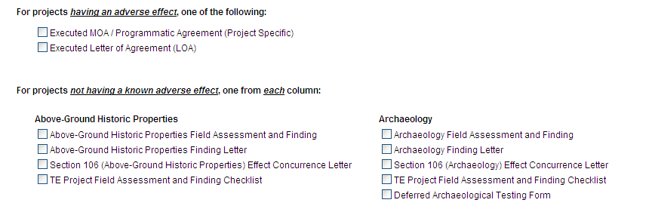
CE Part B, Section A-4 --- Documentation (CQ #195)
Moved “Programmatic Agreement (Project Specific” to its own checkbox under “Deferred Archaeological Testing Form”.

Slide 10
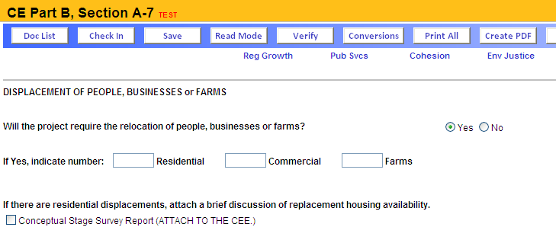
CE Part B, Section A-7 --- Displacement Section (CQ #163)
Reword to say “If there are displacements, analyze the availability of replacement facilities”.

